Slide 1
CSE322
Regular Expressions and regular Sets
............

Slide 2
Regular Expression
Regular Expression is a powerful mathematical tool used to define regular languages, which are recognized by Finite Automata. They are similar to arithmetic, logic, and Boolean expressions in representation but different in their operation and purpose.
Regular expressions generate sets of strings (finite or infinite in number) that always represent a unique and specific regular language.
Each of these regular languages can be recognized and accepted by a finite automata.

Slide 3
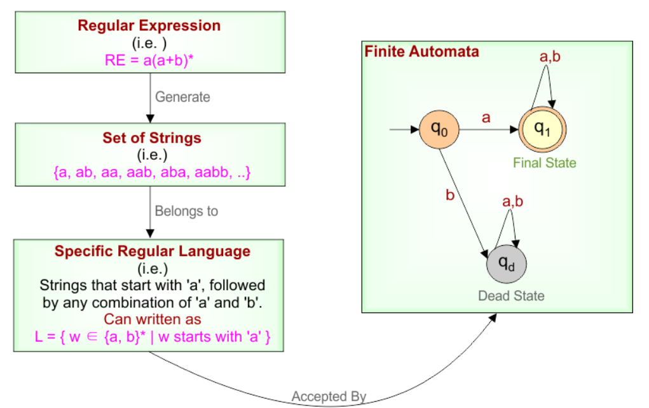

Slide 4
Definition of Regular Expression
A Regular Expression can be recursively defined as follows −
ε is a Regular Expression indicates the language containing an empty string. (L (ε) = {ε})
φ is a Regular Expression denoting an empty language. (L (φ) = { })
x is a Regular Expression where L = {x}

Slide 5
If X is a Regular Expression denoting the language L(X) and Y is a Regular Expression denoting the language L(Y), then
  X + Y is a Regular Expression corresponding to the language L(X) ∪ L(Y) where L(X+Y) = L(X) ∪ L(Y).
  X . Y is a Regular Expression corresponding to the language L(X) . L(Y) where L(X.Y) = L(X) . L(Y)
  R* is a Regular Expression corresponding to the language L(R*)where L(R*) = (L(R))*
If we apply any of the rules several times given above, they are Regular Expressions.

Slide 6
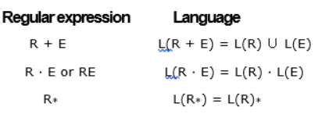
Operators in Regular Expression
There are two binary operations on regular expressions (+ and ·) and one unary operator (*)
These are closely associated with the union, product and closure operations on the corresponding languages.

Slide 7
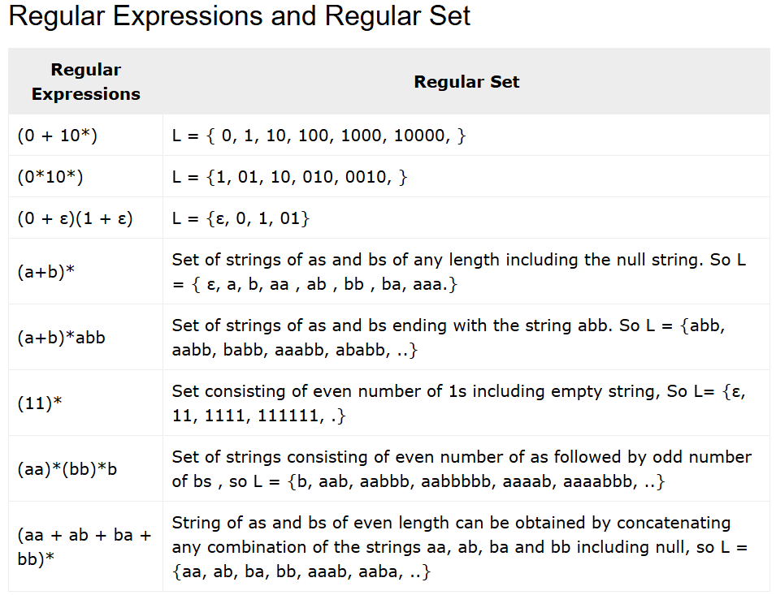
Regular Expressions and Regular Set

Slide 8
Identities for Regular expressions
Regular expressions (RE) are useful tools used in automata theory for pattern matching. Identities of regular expressions are relations that are always true for every regular expression. These identities help simplify and understand complex regular expressions.

Slide 9
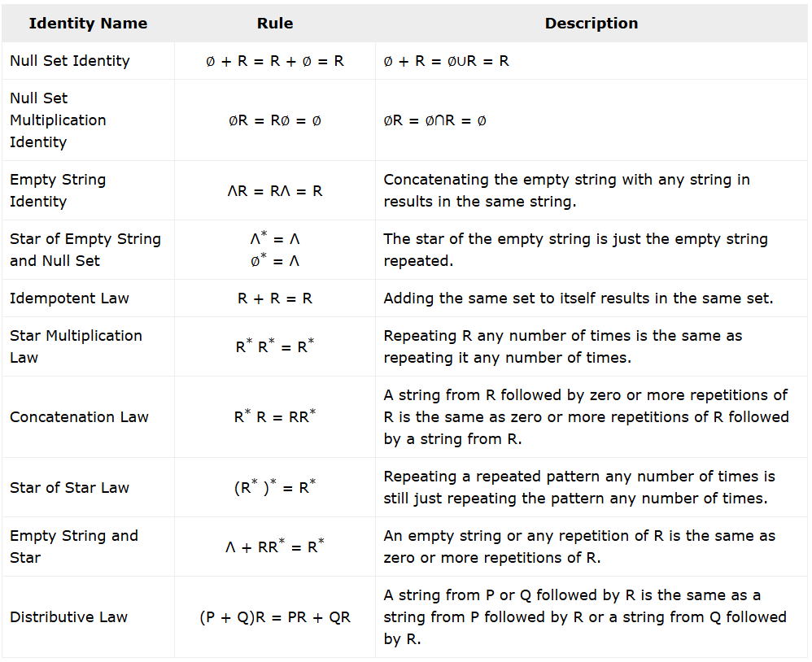

Slide 10
Questions
Describe the following sets by regular expressions:
{101}
{abba}
{01,10}
{Λ ,ab}
{abb,a, b, bba}
{Λ , 0, 00, 000.... }
{1, 11, 111 ... }

Slide 11
Solutions
(a) 101.
(b) abba represents {abba}.
(c) As {01, 10} represented by 01 + 10
(d) The set {Λ , ab} is represented by Λ + ab
(e) The set {abb, a, b, bba} is represented by abb + a + b + bba.
f) As {Λ , 0, 00, 000, ... } is simply {O}*. it is represented by 0*
(g) Any element in {1, 11, 111, ... } can be obtained by concatenating
1 and any element of {1}*. Hence 1(1)* represents {1, 11, 111, ... }

Slide 12
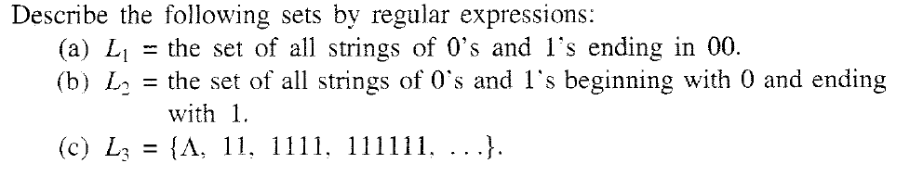
Problem

Slide 13
Solutions
A) (0+1)*00
B) 0 (0+1)* 1
C) (11)*

Slide 14
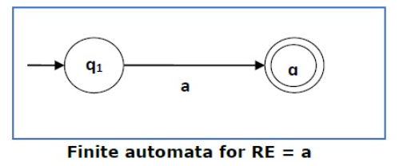
Finite Automata and Regular Expressions
We will reduce the regular expression into smallest regular expressions and converting these to NFA and finally to DFA.
Some basic RA expressions are the following −
Case 1 − For a regular expression “a”, we can construct the following FA −

Slide 15
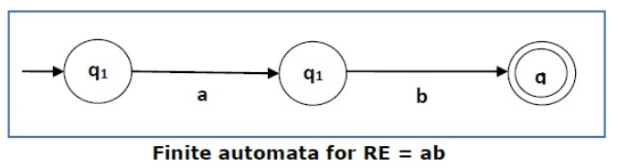
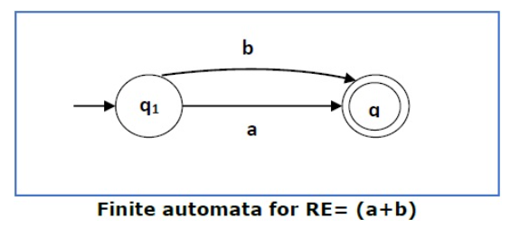
Case 2 − For a regular expression “ab”, we can construct the following FA −
Case 3 − For a regular expression (a+b), we can construct the following FA −

Slide 16
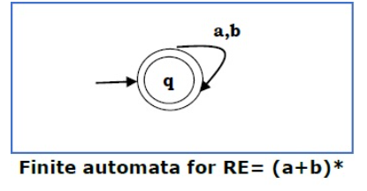
Case 4 − For a regular expression (a+b)*, we can construct the following FA −

Slide 17
Method
Step 1 Construct an NFA with Null moves from the given regular expression.
Step 2 Remove Null transition from the NFA and convert it into its equivalent DFA.

Slide 18
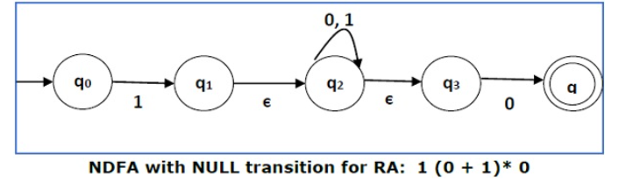
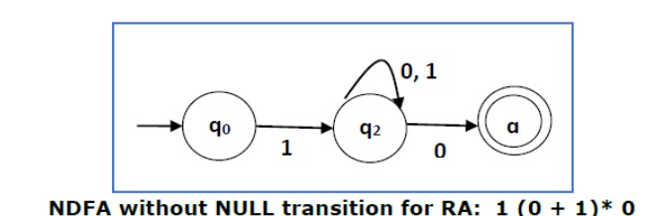
Problem
Convert the following RE into its equivalent DFA − 1 (0 + 1)* 0
Solution: We will concatenate three expressions "1", "(0 + 1)*" and "0“
Now we will remove the ε transitions.

Slide 19
Finite Automata with Null Moves (NFA-ε)
A Finite Automaton with null moves (FA-ε) does transit not only after giving input from the alphabet set but also without any input symbol. This transition without input is called a null move.
An NFA-ε is represented formally by a 5-tuple (Q, ∑, δ, q₀, F), consisting of
Q − a finite set of states
∑ − a finite set of input symbols
δ − a transition function : Q × (∑ ∪ {ε}) → 2^{Q}
q₀ − an initial state q₀ ∈ Q
F − a set of final state/states of Q (F⊆Q).

Slide 20
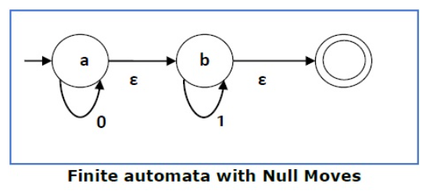
Example
The above (FA-ε) accepts a string set − {0, 1, 01}
L(M)= { 0^{n} 1^{m} | n,m>=0}

Slide 21
Arden’s Theorem
It is used for conversion from FA to RE.
Statement − Let P and Q be two regular expressions. If P does not contain null string, then R = Q + RP has a unique solution that is R = QP*.
Proof −
R = Q + (Q + RP)P [After putting the value R = Q + RP]
= Q + QP + RPP
When we put the value of R recursively again and again, we get the following equation −
R = Q + QP + QP² + QP³..
R = Q (ε + P + P² + P³ + ... )
R = QP* [As P* represents (ε + P + P² + P³ + ... )]
Hence, proved.
(ε + P + P² + P³ + ... )

Slide 22
Assumptions for Applying Ardens Theorem
The transition diagram must not have NULL transitions
It must have only one initial state

Slide 23
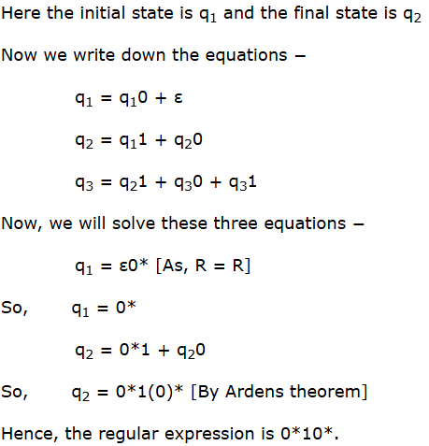
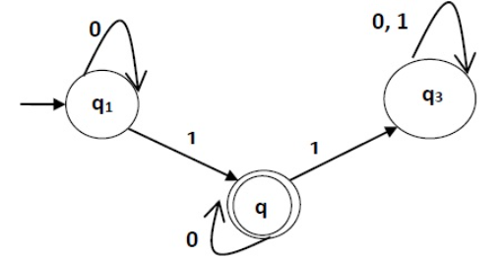
Example:
Construct a regular expression corresponding to the automata given below −

Slide 24
Equivalence of two FA
An Automaton is a machine that has a finite number of states. Any Two Automaton is said to be equivalent if both accept exactly the same set of input strings.
Two Automaton are equivalent if they satisfy the following conditions :
1. The initial and final states of both the automatons must be same.
2. Every pair of states chosen is from a different automaton only.
3. While combining the states with the input alphabets, the pair results must be either both final states or intermediate states.(i.e both should lie either in the final state or in the non-final state).
4. If the resultant pair has different types of states, then it will be non-equivalent. (i.e. One lies in the final state and the other lies in the intermediate state ).

Slide 25
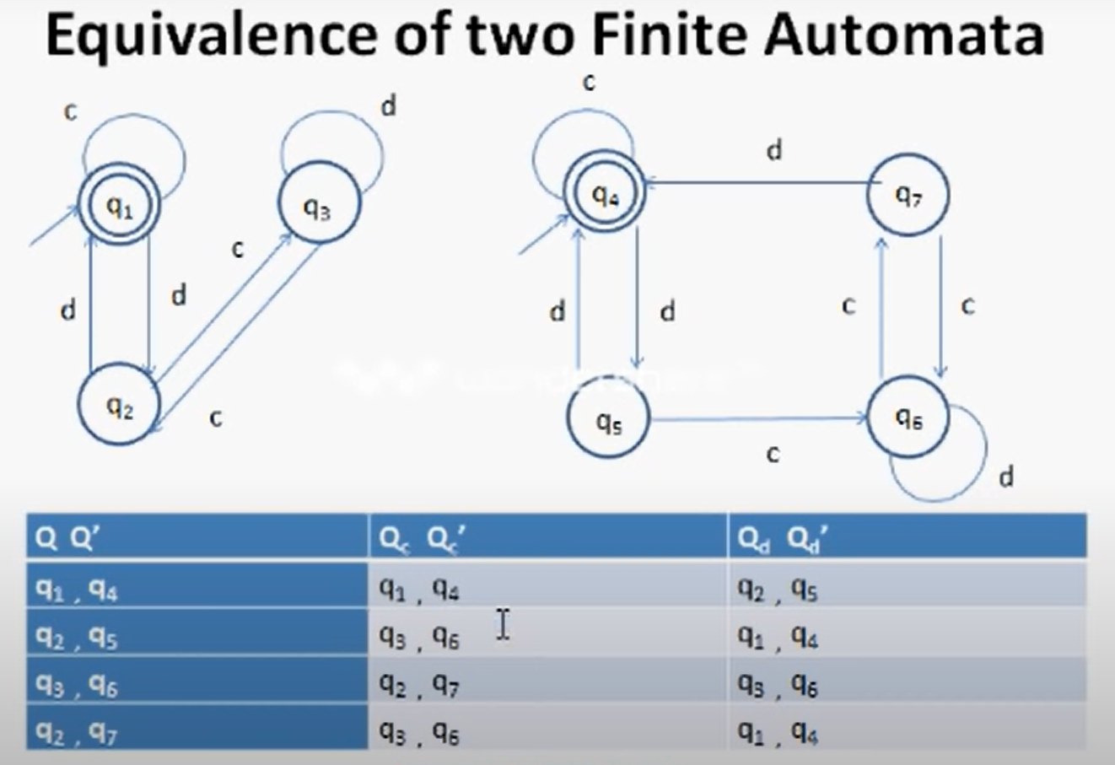
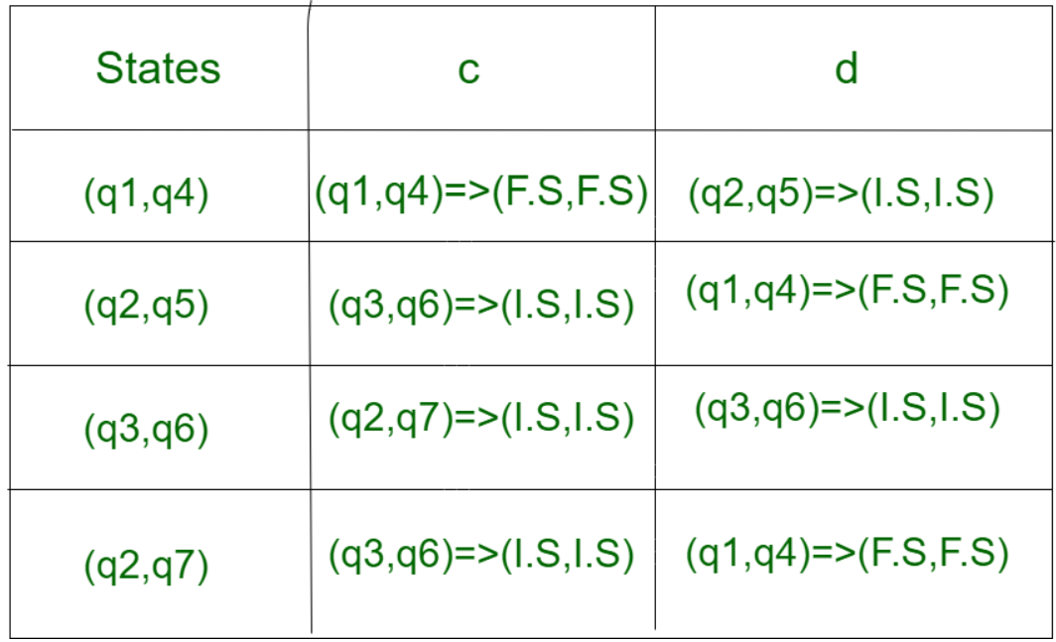
Example 1

Slide 26
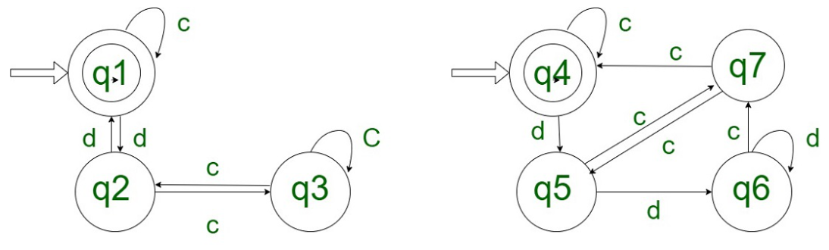
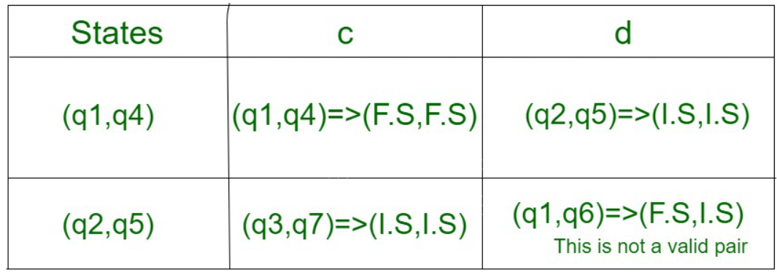
Example 2

